Slide 1
DROWSY DRIVER DETECTION TECHNOLOGY

Slide 2



INTRODUCTION
Road accidents due to driver drowsiness are a major cause of fatalities worldwide
The Drowsy Driver Detection System aims to monitor driver alertness in real time..
It uses Python and OpenCV for detecting eye movements and drowsiness.
Designed to enhance road safety and prevent accidents.

Slide 3
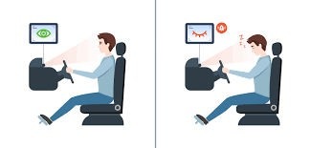
PROBLEM STATEMENT
Fatigue and drowsiness impair a driver's ability to react promptly, increasing the risk of accidents.
Existing solutions like driver monitoring systems are often expensive or limited to
specific vehicles.
Need for an affordable, portable, and effective solution to detect and alert drowsy drivers.

Slide 4
HOW IT WORKS
Project Overview:
The system uses a webcam to continuously capture the driver's facial features.
Eye movement and closure are analyzed in real time to assess drowsiness.
An alert is triggered if prolonged eye closure is detected, indicating fatigue.

Slide 5
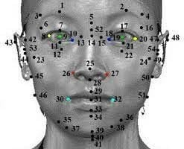
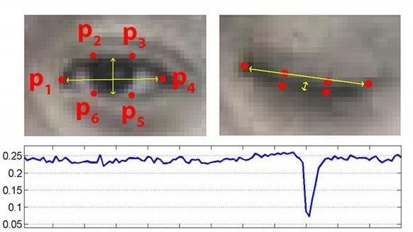
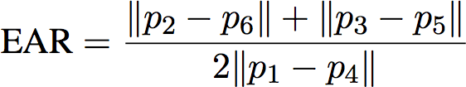
Working Process:
Video Capture: Webcam records real-time footage of the driver's face.
Facial Landmark Detection: Detects the eyes using pre-trained models (shape_predictor_68).
Alert Mechanism: Activates an alarm if EAR falls below a threshold for a set duration.
EAR Calculation(Eye Aspect Ratio): Monitors eye
closure using EAR values.

Slide 6





Technologies Used:
Python: Core programming language for implementation.
OpenCV: For video capture and image processing. dlib: For facial landmark detection and Eye Aspect Ratio (EAR) calculation.
Scipy: For geometric computations like EAR. Pygame: To trigger an audible alert sound.

Slide 7
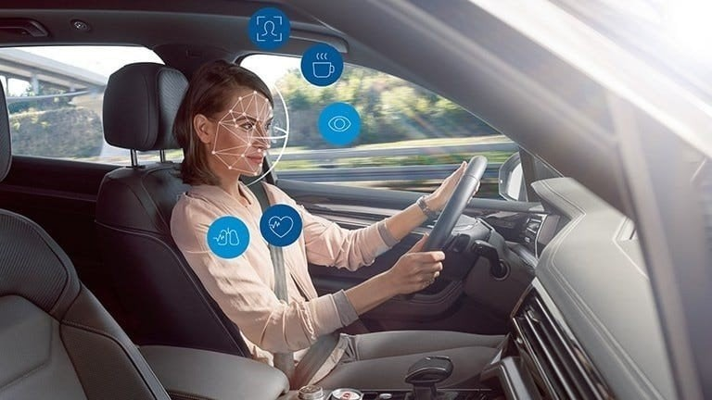
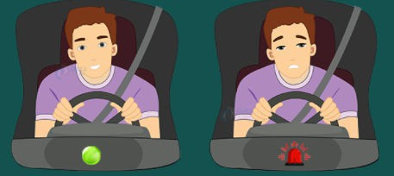
FUTURE IMPROVEMENTS
Portable Device: Create a compact hardware module with a camera and microcontroller.
Mobile Integration: Build a companion app for notifications and remote monitoring.
Enhanced Accuracy: Combine eye tracking
with head movement and heart rate sensors. AI-Powered Features: Use deep learning for advanced fatigue detection.

Slide 8
CONCLUSION
The Drowsy Driver Detection System is a significant step toward enhancing road safety by addressing driver fatigue.
This innovation emphasizes the role of technology in saving lives and promoting safer driving practices.
This project is a testament to the potential of
technology tocreate a more inclusive digital world. We're excited about thefuture possibilities it brings.

Slide 9
K
A
N
Y
H
O
T
U
!

